Slide 1

“PEACE”(A relaxation in your pocket)
Munim Ahemd (192-35-477)
PEACE is a meditation app that helps and process a depressed,anxiety and stress soul to a healthy,shine and beautiful mind.For those we make this app in an art to visible and virtual world. Our motto- ‘A relaxation in your pocket’

Slide 2
Software Requirement Specification PEACE (A relaxation in your pocket) Table of Contents
Chapter1- Introduction Chapter2- User Profile Chapter3- The list of functional and non-functional requirement with requirement prioritization. Chapter4- Use Case Diagram Chapter5- Entity Relationship Diagram Chapter6- Storyboard Chapter7- Database Table Chapter8- Test Case Chapter9- Tarceability Matrix Chapter10- Motive & Exist Problem

Slide 3
The purpose of this document is to describe about our project named PEACE (A Relaxation in your Pocket)with first release. This document contains the functional and non-functional requirements of the project and also user profile, use case, database and storyboard. This document contains the guidelines for system engineers and designers to start working the project.
Chapter 1 Introduction
Scope
PEACE is a meditation app that helps and process a depressed,anxiety and stress soul to a healthy,shine and beautiful mind.
Develop it for well mental health and mindfulness.
Mental well-being wanted human being help from it and can be focused in his life.
By doing some activity and podecast they will gain their goal.
Admin will generate or given the performance stage considering age,gender,preference.
The project task begin In the 2022 March and Primary Ends will be In the Mid of May.(Apprx)

Slide 4
Chapter 2 User Profile
Defination: A user profile is a visual display of personal data associated with a specific user, or a customized desktop environment.

Slide 5
User Profile-1 (User)
User | Character | Requirement
Type | User | Input
Age Range | 15-65 | No Need
Number of User | Unlimited | Subscription
Language | English | Easy Language
Training | No | No
Goal | A Relaxation App | Any Electrical Device

Slide 6
User Profile-1 (Admin)
User | Character | Requirement
Type | Admin | Controlling
Age Range | 20-40 | No Need
Skill | Yes | Management
Language | English | Easy Language
Training | No | No
Goal | A Relaxation App | Any Electrical Device

Slide 7
Chapter 3 Functional Requirement & Non-Functional Requirement
Functional Requirement: A Functional Requirement (FR) is a description of the service that the software must offer.
Non-Functional Requirement: Nonfunctional Requirements (NFR) define system attributes such as security, reliability, performance, maintainability, scalability, and usability.

Slide 8
Functional Requirement
FR01 | Onboarding Activity or Basic Exercise | Starting
FR02 | Meditation Exercise Session (Based on Age,Gender,Preference) | (Sleep,Focus,Workout)
FR03 | Audio/Video for guided meditation | (Sleep,Focus,Workout)
FR04 | Meditation guide sessions and video consultation with experts | (Sleep,Focus,Workout)
FR05 | Meditation sessions based on level (beginner, intermediate or advanced) | (Sleep,Focus,Workout)
FR06 | Favorite meditation tracks and sessions | Profile

Slide 9
Non-Functional Requirement
NFR01 | Social Sign up & Profile Management | Starting
NFR02 | Push notifications for daily basis alert | Onboard
NFR03 | Track progress & Analytics | Profile
NFR04 | Customer support & Feedback | Profile
NFR05 | Add some Buddies for your connective progress | Profile

Slide 10
Chapter 4 Use Case Diagram
Defination: A use case diagram is a graphical depiction of a user's possible interactions with a system.

Slide 11
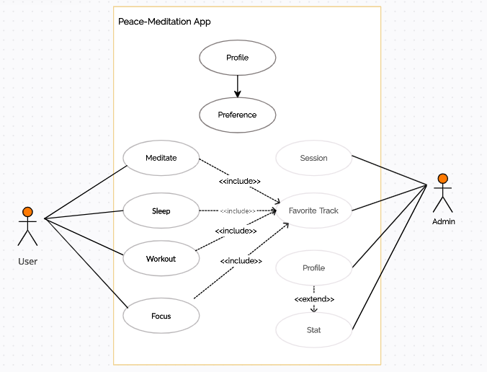
Use case Diagram
Exclude Workshop Blog Video
Actor Admin User
Usecase Complain Collect data Analyse data Action for help Awareness Feedback
Include Evidence

Slide 12
Chapter ER Diagram
ER Diagram: An Entity–relationship model (ER model) describes the structure of a database with the help of a diagram, which is known as Entity Relationship Diagram

Slide 13
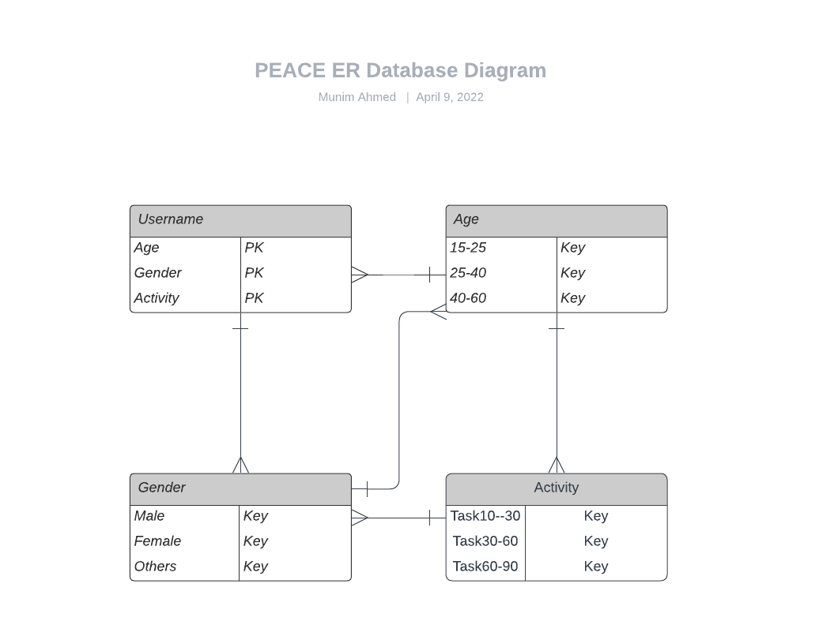
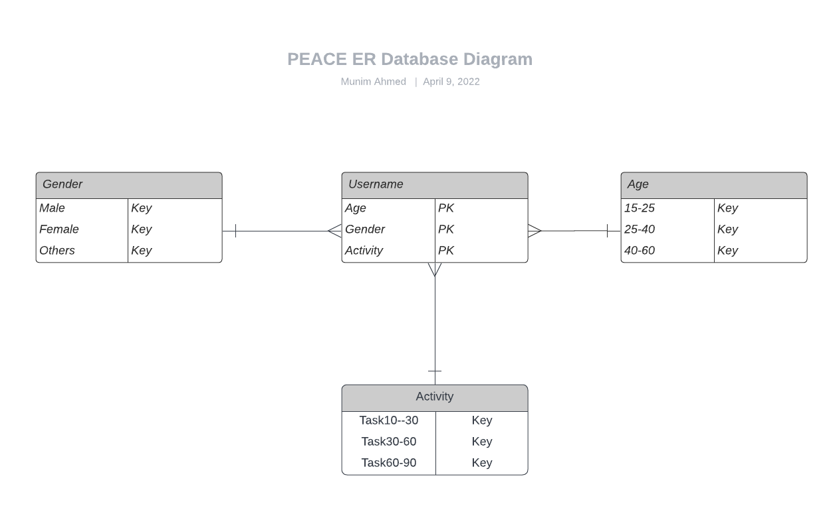

Slide 14
Chapter 5
Features List
Feature: A feature specification is a written description of a feature of a system. · A feature of a system is user-visible aspect of the system that provides the user

Slide 15
1. Registration page & backend mechanism 1.1. Multilingual registration screen 1.2. Enter basic information about a user 1.3. Email/password combination for reg 1.4. OTP support 1.5. General OAuth 2.0 support 1.5.1. Google 1.5.2. Facebook 1.5.3. Linkedin 2. Login page & backend mechanism 2.1. Multilingual login screen 2.2. Email/password combination to log in 2.3. Ability to restore password 3. Home page & API methods 3.1. Favorites and Recent cards (Store the task user add into thier fav list or thier recent activity) 3.2. Featured Collection (All featured for the user profile) 3.3. Daily Round Activity(Morning,Afternoon,Night three category will be displayed) 3.4. Backend works to support API for stats and table of scans.

Slide 16
4. Specific Function Page 4.1. Meditation -Featured(like Basic,Breathe,Letting go of stress) -Recent -Explore Meditate Task(Guidance,Step by step Card) 4.2. Sleep -Featured(Music,Story,Podecast) -Recent -Explore Sleep(Guidance,Step by step Card) 4.3. Move -Featured(Task,Exercise) -Recent -Explore Move(Guidance,Step by step card) 4.4. Focus -Featured(Breathing,Thoughts,Yoga) -Recent -Explore Focus(Guidance,Step by step cards) 5. Profile 5.1. Reflect (User progress,Check out of activity) 5.2. Stats (Starting to end journey Statistics) 5.3. Buddies (Connecting with friends for progress and quality time) 5.4. Settings (Account and Subscription,Notification, Terms,User Data)

Slide 17
6. Super Admin Feature 6.1. Dashboard View and Controling 6.2. User Subscription Management 6.3. AccountProfile Management 6.4. Backend API methods to get data, edit information, manage information 7. Non-Register User 7.1. All Existing Page and Service provided for 7 days trial version. 7.2. Excluding Explore section(Guidance,Step by step Cards)

Slide 18
Chapter 5 Database Table
Database Table: A table is a collection of related data held in a table format within manipulate data. It consists of columns and rows.

Slide 19
Age | Task
15-25 | Task:1-Task:20
25-40 | Task:20-Task:40
40-60 | Task:40-Task:60
Gender | Task
Male | Task:01-Task:10 Task:30-Task:40 Task:50-Task:60
Female | Task:01-Task:10 Task:20-Task:30 Task:50-Task:60
Bisexual/Homosexual/Transgender | Task:01-Task:10 Task:30-Task:40 Task:50-Task:60
Preference | Task
Mindfulness | Task:01-Task:10 Task:30-Task:40 Task:50-Task:60
Stress & Anxiexty | Task:01-Task:10 Task:20-Task:30 Task:50-Task:60
Sleep | Task:01-Task:10 Task:30-Task:40 Task:50-Task:60

Slide 20
Username | Age | Gender | Activity
x | 20 | Male | Task:1 - Task10
y | 23 | Female | Task:10 – Task:20
z | 29 | Female | Task:20 – Task:30
x1 | 30 | Others | Task:30 - Task:40
Y1 | 50 | Male | Task:50 - Task:60

Slide 21
Chapter 6 Test Case
Database Table: A table is a collection of related data held in a table format within manipulate data. It consists of columns and rows.

Slide 22
Chapter StoryBoard
Database Table: A table is a collection of related data held in a table format within manipulate data. It consists of columns and rows.

Slide 23
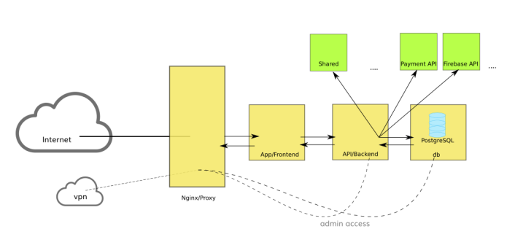
Diagram
Fig1.1:A diagram of Server Processing of Website
কারা কারা আসতেছিস,১৫ ই এপ্রিল?

